Slide 1
Chapter 3
Physical Layer Cabling:
Fiber Optics

Slide 2
Objectives
Describe the advantages of glass fiber over copper conductors.
Describe the differences in how light travels in single and multimode fiber.
Define attenuation and dispersion in fiber optic cabling
Describe the components of a fiber optic system
Describe the issues of optical networking including fiber-to-the-business and fiber-to-the-home.

Slide 3
Objectives
Describe the new networking developments associated with optical Ethernet.
Calculate a complete power budget analysis for a fiber-optic system.
Understand the safety issues when working with fiber optics.

Slide 4
Advantages of Fiber
1. Extremely wide system bandwidth: The intelligence is impressed on the light varying the light's amplitude. The amount of information multiplexed on such a system, in the hundreds of Gbps, is indeed staggering.
2. Immunity to electrostatic interference: External electrical noise and lightning do not effect energy in a fiber-optic strand. However, this is true only for the optical strands, not the metallic cable components or connecting electronics.
3. Elimination of crosstalk: The light in one glass fiber does not interfere with, nor is it susceptible to, the light in an adjacent fiber. Recall that crosstalk results from the electromagnetic coupling between two adjacent copper wires.
4. Lower signal attenuation than other propagation systems: Typical attenuation of a 1-Ghz bandwidth signal for optical fibers is 0.03 dB per 100ft, compared to 4.0 dB for RG-58U coaxial.

Slide 5
Advantages of Fiber
5. Lower costs: Optical-fiber costs are continuing to decline. The costs of many systems are declining with the use of fiber, and that trend is accelerating.
6. Safety: In many wired systems, the potential hazard of short circuits requires precautionary designs. Additionally, the dielectric nature of optic fibers eliminates the spark hazard.
7. Corrosion: Since glass is basically inert, the corrosive effects of certain environments are not a problem.
8. Security: Due to its immunity to and from electromagnetic coupling and radiation, optical fiber can be used in most secure environments. Although it can be intercepted or tapped, it is very difficult to do so.

Slide 6
Fiber-optic systems
The commonly used wavelengths in today's fiber-optic systems are 750 to 850 nm, 1310 nm, and 1530 to 1560 nm.
There is investigative work currently underway in the 1600- to 1625-nm range.
Fixed fiber-optic wavelength specifications are simply stated in terms of fixed wavelengths as 850, 1310,or 1550 nm.

Slide 7
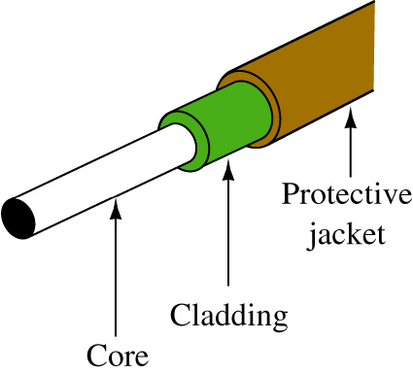
Optical Fiber Construction
Typical construction of an optical fiber is shown. The core is the portion of the fiber strand that carries the transmitted light. Its chemical composition is simply a very pure glass; silicon dioxide, doped with small amounts of germanium, boron, and phosphorous.
The cladding is the material surrounding the core. It is almost always glass, although plastic cladding of a glass fiber is available but rarely used. In any event, the refraction index for the core and the cladding are different. A plastic coating surrounds the cladding to provide protection.

Slide 8
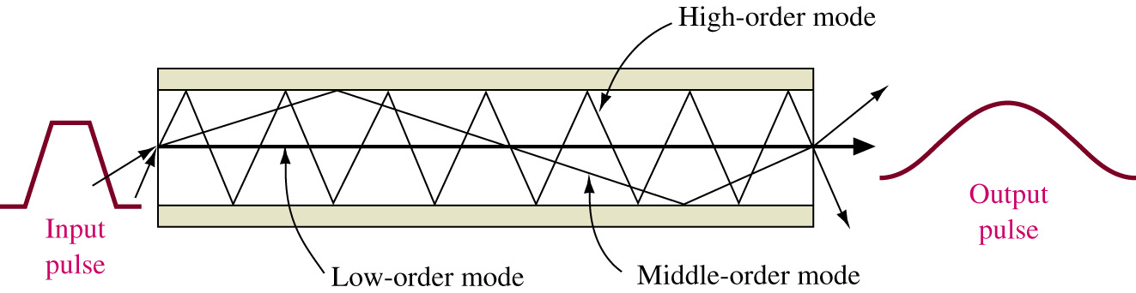
Modes of Propagation
A graphic of a fiber showing three different modes (i.e., multimode) of propagation is presented. The lowest-order mode is seen traveling along the axis of the fiber, and the middle-order mode is reflected twice at the interface. The highest-order mode is reflected many times and makes many trips across the fiber. As a result of these variable path lengths, the light entering the fiber takes a variable length of time to reach the detector. This results in a pulse-broadening or dispersion characteristic, as shown in Fig. 12-5. This effect is termed pulse dispersion and limits the maximum distance and rate at which data (pulses of light) can be practically transmitted.

Slide 9
Modes of Propagation
As a result of these variable path lengths, the light entering the fiber takes a variable length of time to reach the detector. This results in a pulse-broadening or dispersion characteristic, as shown. This effect is termed pulse dispersion and limits the maximum distance and rate at which data (pulses of light) can be practically transmitted. You will also note that the output pulse has reduced amplitude as well as increased width.

Slide 10
Modes of Propagation
The greater the fiber length, the worse this effect will be. As a result, manufacturers rate their fiber in bandwidth per length, such as 400 MHz/km. This means the fiber can successfully transmit pulses at the rate of 400 MHz for 1 km, 200 MHz for 2 lkm, and so on. In fact, current networking standards limit multimode fiber distances to 2 km. Of course, longer transmission paths are attained by locating regenerators at appropriate locations. Step-index multimode fibers are rarely used in networking due to their very high amounts of pulse dispersion and minimal bandwidth capability.

Slide 11
Graded-index Fiber
In an effort to overcome the pulse dispersion problem, the graded-index fiber was developed. Graded-index multimode fibers with 50-μm-diameter cores and 125-μm cladding are used in many telecommunication systems at up to 300 megabits per second (Mbps) over 50-km ranges without repeaters.
Graded-index fiber with up to a 100-μm core is used in short-distance applications that require easy coupling from the source and high data rates, such as for video and high-speed local area networks. The larger core affords better light coupling than the 50-μm core and does not significantly degrade the bandwidth capabilities.
In the telecommunications industry, there are two commonly used core sizes for graded-index fiber, these being 50 and 62.5 μm. Both have 125-μm cladding. The large core diameter and the high NA (numerical aperture) of these fibers simplify input cabling and allow the use of relatively inexpensive connectors. Fibers are specified by the diameters of their core and cladding. For example, the fibers just described would be called 50/125 fiber and 62/125 fiber.

Slide 12
Single-mode Fiber
The single-mode fiber, by definition, carries light in a single waveguide mode. A single-mode fiber will transmit a single mode for all wavelengths longer than the cut- off wavelength. A typical cutoff wavelength is 1260 nm. At wavelengths shorter than the cutoff, the fiber supports two or more modes and becomes multimode in operation.
Single-mode fibers are widely used in long-haul and wide area network applications. They permit transmission of about 10 Gbps and a repeater spacing of up to 80 km. These bandwidth and repeater spacing capabilities are constantly being upgraded by new developments.

Slide 13
There are two key distance-limiting parameters in fiber-optic transmissions: attenuation and dispersion.
Attenuation is the loss of power introduced by the fiber. This loss accumulates as the light is propagated through the fiber strand, The loss is expressed in dB/km (decibels per kilometer) of length.
The loss, or attenuation, of the signal is due to the combination of four factors: scattering, absorption, macrobending, and microbending.

Slide 14
Attenuation factors
Scattering: This is the primary loss factor over the three wavelength ranges used in telecommunication systems. It accounts for 85% of the loss. The scattering is known as Rayleigh scattering and is caused by refractive index fluctuations. Rayleigh scattering decreases as wavelength increases.
Absorption: The second loss factor, a composite of light interaction with the atomic structure of the glass. It involves the conversion of optical power to heat. One portion of the absorption loss is due to the presence of OH hydroxol ions dissolved in the glass during manufacture. These cause the water attenuation or OH peaks shown in the next slide.

Slide 15
Splicing
Optical fiber is made of ultrapure glass. Optical fiber makes window glass seem opaque by comparison.
A window made of this pure glass 1 km thick would be as transparent as a normal pane of glass. It is therefore not surprising that the process of making connections from light source to fiber, fiber to fiber, and fiber to detector becomes critical in a system.
The low-loss capability of the glass fiber can be severely compromised if these connections are not accomplished in exacting fashion.

Slide 16
Splicing
Optical fibers are joined either in a permanent fusion splice or with a connector. The connector allows repeated matings and un-matings.
Above all, these connections must lose as little light as possible. Low loss depends on correct alignment of the core of one fiber to another, or to a source or detector. Loss occurs when two fibers are not perfectly aligned within a connector.

Slide 17
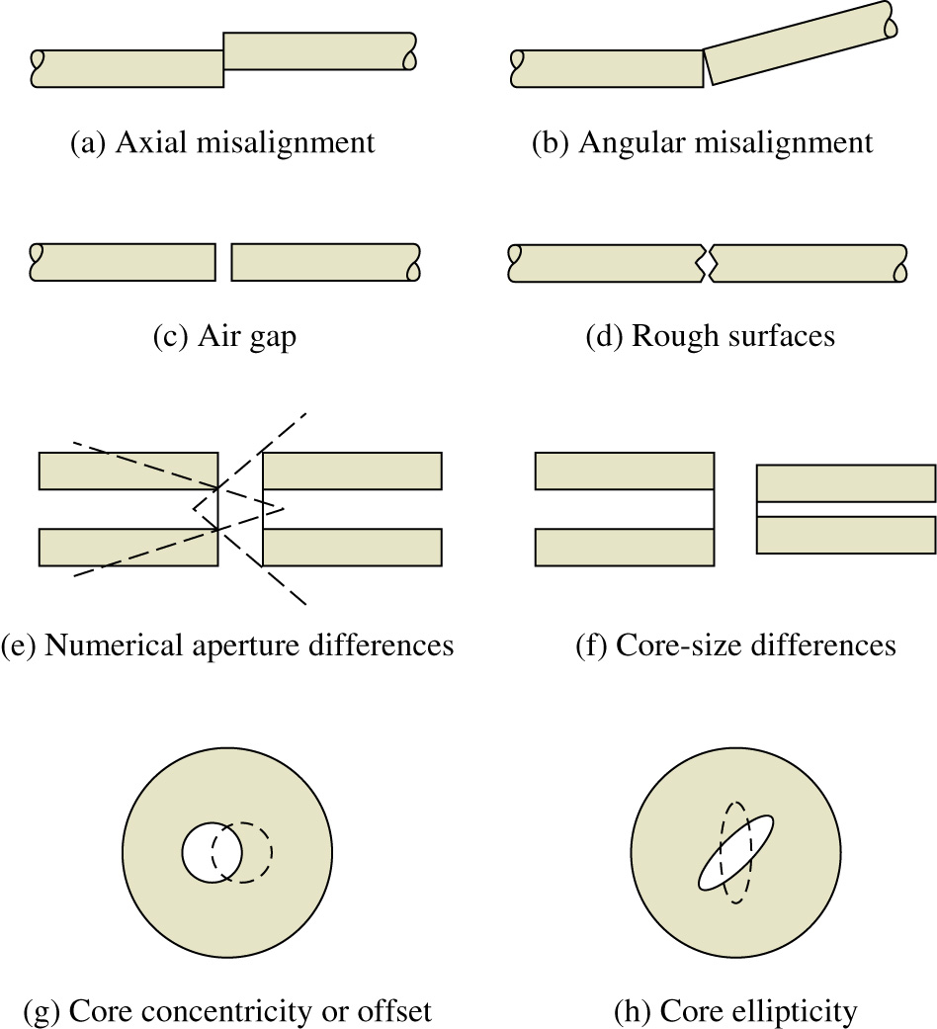

Slide 18
Fusion Splicing
In regard to connectorization and splicing, there are two techniques to consider for splicing. Fusion splicing is a long-term method, in which two fibers are fused or welded together. The two ends are stripped of their coating, cut or cleaved, and inserted into the splicer, The ends of the fiber are aligned and an electric arc is fired across the ends, melting the glass and fusing the two ends together.
There are both manual and automatic fusion splicers; the choice usually depends on the number of splices to be done on a given job, technician skill levels available, and, of course, the budget. Typical insertion losses of less than 0.1 dB-frequently in the 0.05-dB range-can be consistently achieved.

Slide 19
Mechanical Splices
Mechanical splices can be permanent and an economical choice for certain fiber-splicing applications. Mechanical splices also join two fibers together, but they differ from fusion splices in that an air gap exists between the two fibers. This results in a glass-air-glass interface, causing a severe double change in the index of refraction. This change results in an increase in insertion loss and reflected power.
The condition can be minimized by applying an index-matching gel to the joint. The gel is a jellylike substance that has an index of refraction much closer to the glass than air. Therefore, the index change is much less severe.
The best method for splicing depends on the application, including the expected future bandwidth (i.e., gigabit), traffic, the job size, and economics.

Slide 20
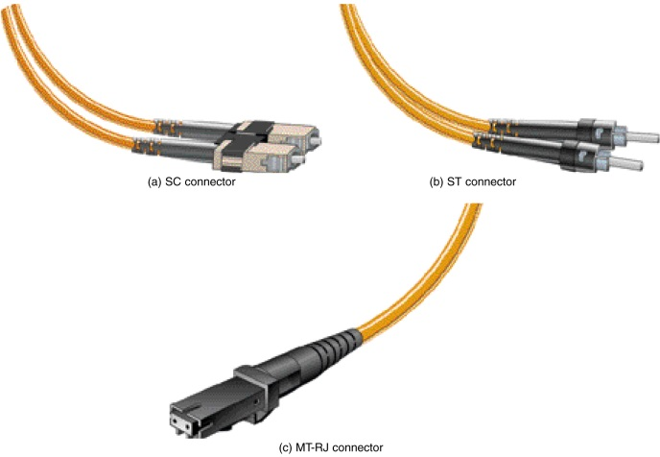
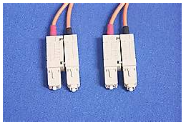
Fiber Connectorization
For fiber connectorization, there are several choices on the market such as SC, ST, FC.LC, MT-RJ and others. The choice of the connector is typicaslly dictated by the hardware being used and the fiber application. Examples of SC, ST, MT-RJ, and LC connectors are provided.

Slide 21
Introduction
The need for increased bandwidth is pushing the fiber-optic community into optical networking solutions that are almost beyond the imagination of even the most advanced networking person.
Optical solutions for long-haul, wide area, metropolitan, campus networks, and local area networks are available. Cable companies are already using the high-bandwidth capability of fiber to distribute cable programming as well as data throughout their service areas.

Slide 22
Introduction
Optical networks are becoming a major part of data delivery in homes, businesses, and for long-haul carriers. The telecommunications industry has been using fiber for carrying long-haul traffic for many years.
Some major carriers are merging with cable companies so that they are poised to provide high-bandwidth capabilities to the home.

Slide 23
SONET Hierarchy Data Rates
Signal Bit Rate Capacity
OC-1 (STS-1) 51,840 Mbps 28DS-Is or 1 DS-3
OC-3 (STS-3) 155.52 Mbps 84DS-Is or 3 DS-3s
OC-12 (STS-12) 622.080 Mbps 336 DS-1s or 12 DS-3s
OC-48 (STS-48) 2.48832 Gbps 1344 DS-1s or 48 DS-3s
OC-192 (STS-192) 9.95328 Gbps 5376 DS-Is or 192 DS-3s
OC: Optical carrier DS-1: 1.544 Mbps
STS: Synchronous transport signal DS-3: 44.736 Mbps

Slide 24
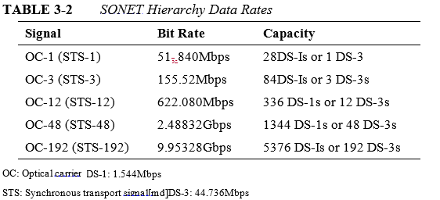
SONET/SDH
When carrying digital signals over SONET, the signal is essentially enveloped or encapsulated within the optical carrier. Table 3-2 lists the more common data rates. The table shows the capacity not equivalence. It merely states that OC-1 is capable of carrying 28 DS-1s or 1 DS-3. With the conversion overhead, it yields a bit rate of 51.84 Mbps when carrying one DS-3 signal.

Slide 25
FTTB
Another architecture in place is fiber to the business (FTTB). A fiber connection to a business provides for the delivery of all current communication technologies including data, voice, video, conferencing, etc.

Slide 26
Optical Ethernet
Conventional high speed Ethernet networks are operating over fiber. This is called optical Ethernet and uses the numerics such as:
10BaseF, 100BaseFX, 1000BaseSX, 10GB
Fiber helps to eliminate the 100-m distance limit associated with unshielded twisted-pair (UTP) copper cable.

Slide 27

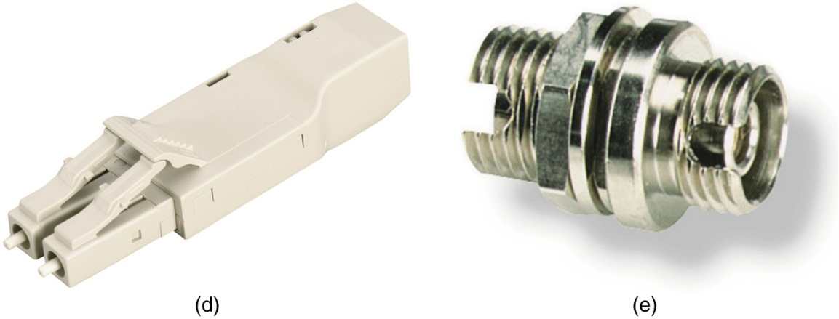

Slide 28
Safety
The eye can’t see fiber optic communication wavelengths, so there is no pain or awareness of exposure. However the retina can still be exposed and damaged.
Use extreme causing when working with fiber. Dangers include:
Glass
LEDs

Slide 29
Safety
Do not look into the end of a fiber.
Use safety glasses
Fiber ends are brittle, they can get embedded into the skin

